Slide 1


Phased Array
Ralph Noeske, Ph.D.
Applied Science Laboratory, Europe

Slide 2
Data Format – Single Element Coil
Header
X*Y*Z Data-Matrix in k-space
⇓
1-3 D spatial DFT
X*Y*Z Data-Matrix with FIDs
⇓
1 D spectral DFT
X*Y*Z Data-Matrix with spectra
⇓
water-suppressed metabolite signal

Slide 3
Data Format – Phased-Array Coil
Header
Coil 1
Coil 2
Coil 3
Coil n
⇓
sdbm
*_1.shf
*_2.shf
Each data-set from the
different coils can be treated
as an independent, full set
of raw data!
*_n.shf

Slide 4
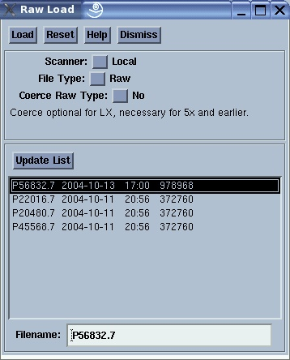
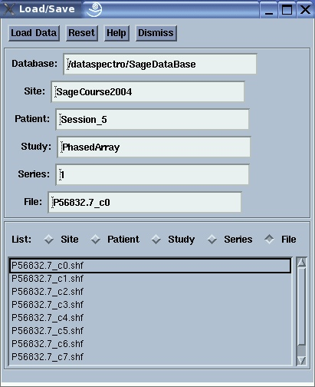
Phased-Array Coil – Load procedure

Slide 5
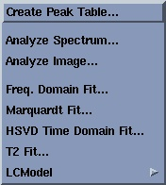
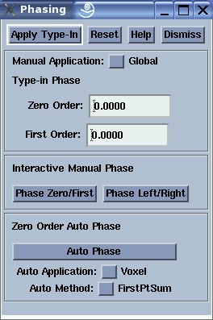
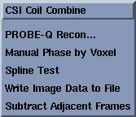
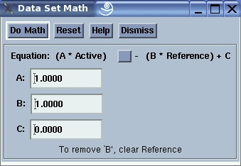
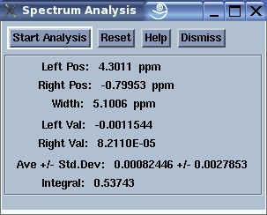
Phased-Array Data – Recombination
Tools

Slide 6
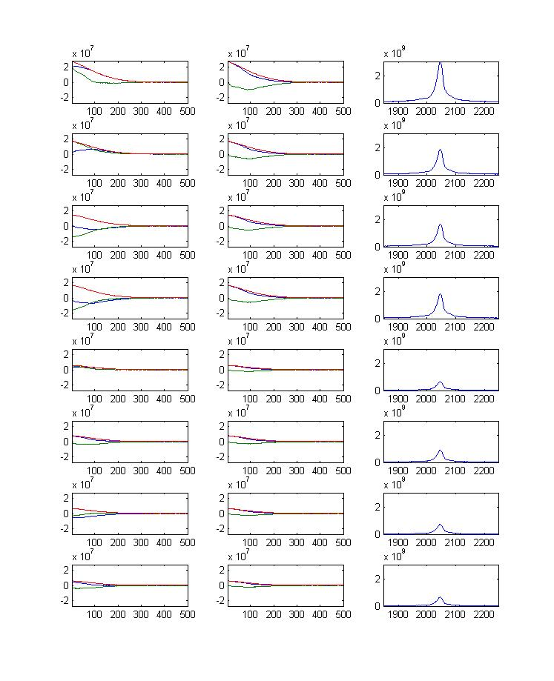
Phased-Array Data – Recombination
Coil weighting
w(i)
Phase difference
Δϕ(i)

Slide 7
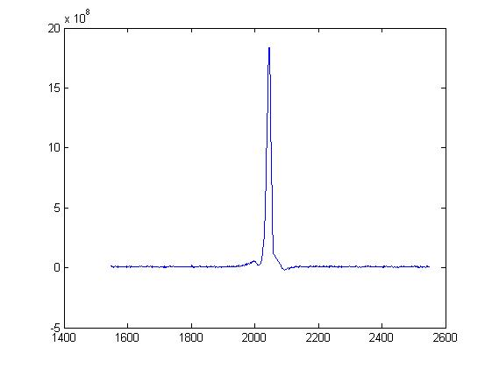
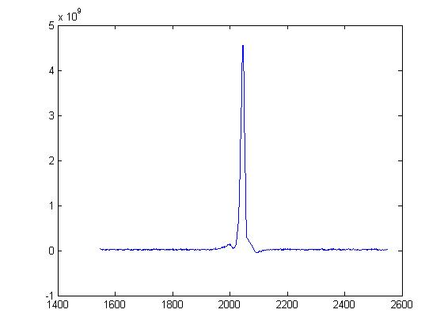
Coil weighting w(i)
s(i): signal intensity of each coil element, e.g. s(i) = MAX(ABS(FID(i)))
Method 1:
ss = Σs(i), w(i) = s(i) / ss
Σw(i) = 1
noise level gets scaled
Method 2 (SAGE, SM Wright, NMR in Biomedicine, V10, 394 - 410):
ss = {Σ[s(i)]²}^{½}, w(i) = s(i) / ss
Σ[w(i)]² = 1
noise level doesn’t change
coil# | w(i) | Δϕ(i)
1 | 0.2667 | 0
2 | 0.1667 | -0.6951
3 | 0.1457 | 2.2868
4 | 0.1618 | 2.5336
5 | 0.0577 | -0.3643
6 | 0.078 | 1.0091
7 | 0.0652 | -2.956
8 | 0.0584 | 1.3891
coil# | w(i) | Δϕ(i)
1 | 0.6598 | 0
2 | 0.4124 | -0.6951
3 | 0.3604 | 2.2868
4 | 0.4003 | 2.5336
5 | 0.1427 | -0.3643
6 | 0.1929 | 1.0091
7 | 0.1613 | -2.956
8 | 0.1446 | 1.3891

Slide 8
Phased-Array Data – Recombination
Data frames
d(i)
Coil weighting
w(i)
Phase difference
Δϕ(i)
d(i)
multiple receiver combine, w(i), Δϕ(i)
⇓
⇓
phase correction
d
⇓
⇓
FFT
phase correction
⇓
⇓
multiple receiver combine, w(i)
FFT
⇓
⇓
final spectrum
final spectrum

Slide 9
Thank You
ralph.noeske@ge.com

